Slide 1

Environmental Justice for Climate Refugees
Book Presentation
Francesca Rosignoli, PhD/Postdoc
Department of Public Law – Tarragona, Spain (CEDAT – URV) francesca.rosignoli@urv.cat

Slide 2
Main goals of the presentation
Why do Climate Refugees are not recognized?
Conceptual obstacles
Empirical shortcomings
Legal impasse
Legal proposals and ongoing initiatives
An environmental justice approach to overcoming the legal impasse

Slide 3
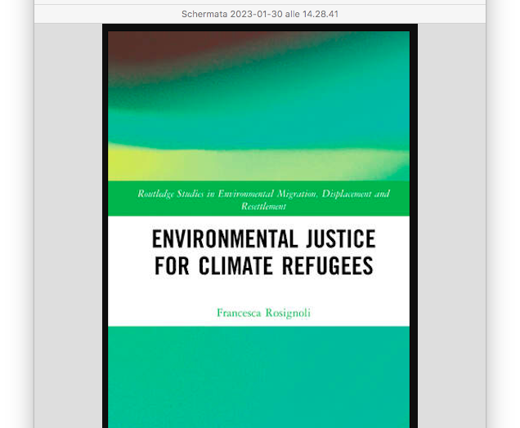


Slide 4
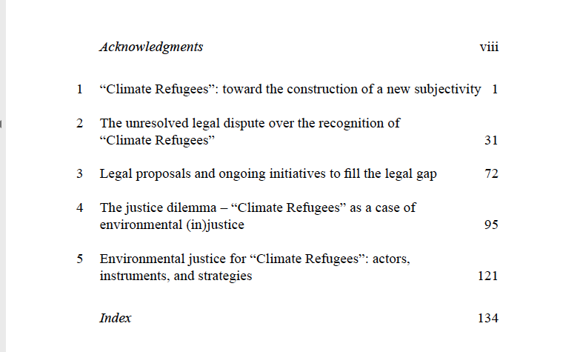
Table of contents

Slide 5
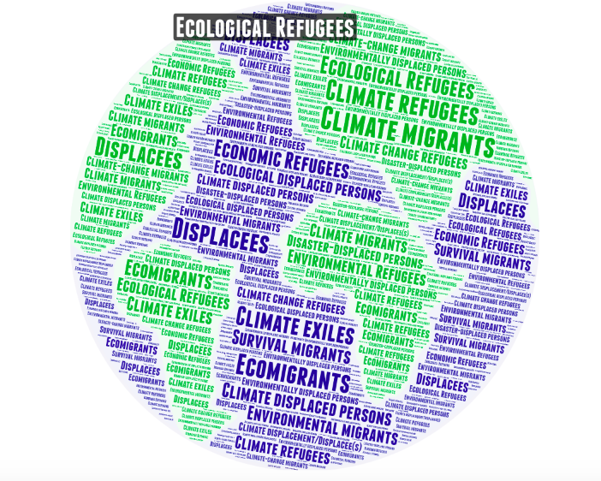
Conceptual obstacles: Lost in Labels

Slide 6
Environmental Refugees are
«Those people who have been forced to leave their traditional habitat, temporarily or permanently, because of a marked environmental disruption (natural and/or triggered by people) that jeopardized their existence and/or seriously affected the quality of their life.»
(El-Hinnawi, 1985:4)

Slide 7
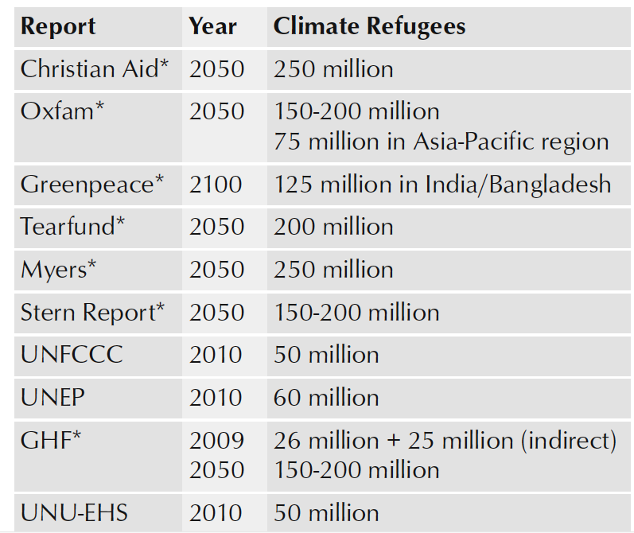
Empirical shortcomings
MAXIMALISTS
VS
MINIMALISTS
Source: (Jakobeit & Methmann 2012)

Slide 8
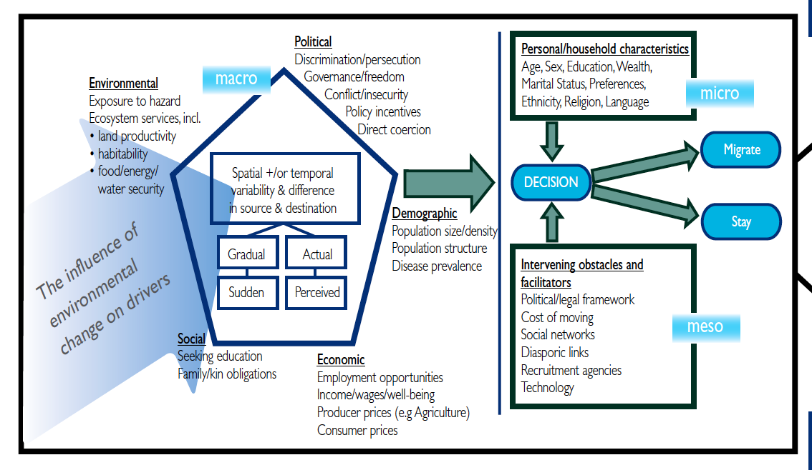
Climate migration: a multi-causal phenomenon
Source:
(Foresight, 2011)

Slide 9
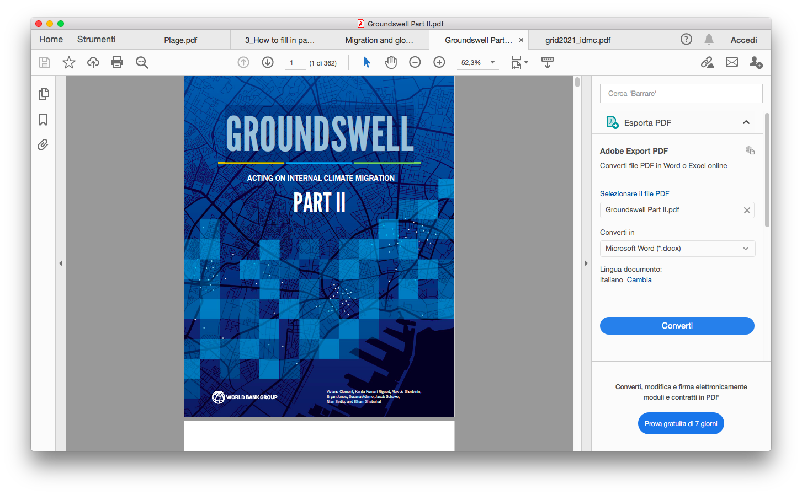

Available Data
Climate change could force 216 million people across six world regions to move within their countries by 2050 (World Bank 2021).
Natural disasters triggered more than half as many displacements as armed conflicts and violence. In 2023, 7.7 million people had to leave their homes due to ecological disasters (IDMC 2024).

Slide 10
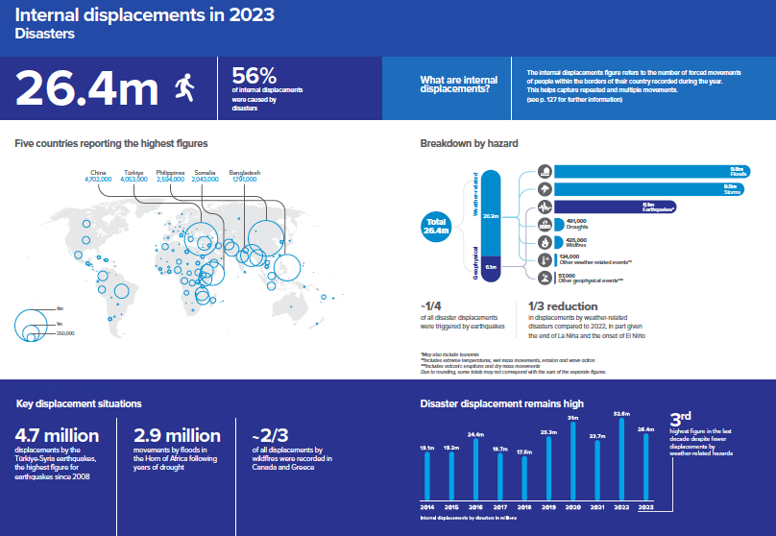

Slide 11
Climate migration: a heterogenous phenomenon
Slow-onset events
SEA-LEVEL RISE
Rapid-onset events
FLOODS
GROUNDWATER AND SOIL SALINIZATION
DROUGHTS
DESERTIFICATION
STORMS
HURRICANES
TYPHOONS
CYCLONES
MUDSLIDES

Slide 12
Should I stay or Should I go Dilemma
MOVE
CHOOSE TO LEAVE (MIGRATION)
FORCED TO MOVE (DISPLACE
MENT)
STAY
UNABLE TO LEAVE (TRAPPED)
CHOOSE TO STAY (IMMOBILE)

Slide 13


Legal shortcomings: The legal gap
Internally displaced persons (IDPs)
(Climate) Refugees
Forced movement outside the country of origin
Migrants
Voluntary movement
Forced movement within national borders
1998 UN Guiding Principles on Internal Displacement
2009 Kampala Convention
Global Compact 2018
2013 Peninsula Principles on Climate Displacement within States

Slide 14
The legal Impasse

Slide 15
The legal Impasse
The 1951 Refugee Convention read in conjunction with its 1967 Protocol defines a refugee as a person who:
“owing to well-founded fear of being persecuted for reasons of race, religion, nationality, membership of a particular social group or political opinion, is outside the country of his nationality and is unable, or owing to such fear, is unwilling to avail himself of the protection of that country; or who, not having a nationality and being outside the country of his former habitual residence as a result of such events, is unable or, owing to such fear, is unwilling to return to it.”

Slide 16
Legal proposals
Stand-alone universal treaty (Docherty & Giannini, 2009; Hodgkinson, Burton, Anderson, & Young, 2010; Prieur et al., 2008)
Regional-based, including bilateral agreements (Mcadam, 2011; Williams, 2008);
Extension of the mandate and funding of the UNHCR (Ferracioli, 2014);
Piggy-backing approach on existing regimes (Biermann, 2018; Biermann & Boas, 2008, 2010; Kent & Behrman, 2018);
Combination of existing legal tools with a new multilateral treaty and complementary measures (Pèrez, 2018).

Slide 17
Ongoing initiatives
2013 Nansen Initiative’s agenda for the Protection of Cross-Border Displaced Persons in the Context of Disasters and Climate Change (SEE: Platform on Disaster Displacement, PDD).
2013 Peninsula Principles on Climate Displacement within States
2014 The Migrants in Countries in Crisis (MICIC) Initiative
2015 International Organization for Migration Division on Migration, Environment and Climate Change (MECC) (SEE: Institutional Strategy on Migration, Environment and Climate Change, 2021-2030)
2015 UNFCCC-led Task Force on Displacement

Slide 18
Ongoing initiatives
2016 International Law Commission (ILC) Draft Articles on the Protection of Persons in the Event of Disasters
2018 International Law Association (ILA) Sydney Declarations of Principles on the Protection of Persons Displaced in the context of Sea Level Rise
United Nations High Commissioner for Refugees (UNHCR) initiatives (UNHCR, 2018, 2019) on international protection made in the context of the adverse effects of climate change and disasters

Slide 19
An Environmental Justice Approach
Ensure the same degree of protection for people on the move facing the same situations of vulnerability
Legal analogy between “climate” and “political” refugees can be drawn along the line of vulnerability
Overcome state inaction

Slide 20
Decolonial Environmental Justice
COLONIALITY
Power
Knowledge
Being
(Álvarez & Coolsaet, 2020)

Slide 21
Decolonial Environmental Justice
The tripartite notion of coloniality
The coloniality of power
imposition of Western forms of power, such as the nation-state
mobility injustice
The coloniality of knowledge
single accepted (Western) definition of a refugee
epistemological violence
The coloniality of being
construction of hierarchical subjectivities
dehumanization of uncategorized “climate refugees” (irregular migrants)

Slide 22
Is the State the only game in town?
Climate Change Litigation: unlocking the creative powers of judges to fill the legal gap
Non-state actors empowerment: building alternative, translocal policies, and climate actions to resist or adapt to environmental disruptions

Slide 23
References
﻿Álvarez, L., & Coolsaet, B. (2020). Decolonizing Environmental Justice Studies: A Latin American Perspective. Capitalism Nature Socialism, 31(2), 50–69.
Biermann, F., & Boas, I. (2008). Protecting Climate Refugees: The Case for a Global Protocol. Environment, 50(6), 8–17. https://doi.org/10.3200/ENVT.50.6.8-17
Biermann, F., & Boas, I. (2010). Preparing for a warmer world: Towards a global governance system to protect climate refugees. Global Environmental Politics, 10(1), 60–88. https://doi.org/10.1162/glep.2010.10.1.60
Biermann, F. (2018). Global governance to protect future climate refugees. In S. Behrman & A. Kent (Eds.), Climate Refugees: Beyond the Legal Impasse? (pp. 265–277). New York: Routledge. https://doi.org/10.4324/9781315109619
﻿Clement, V., Rigaud, K. K., de Sherbinin, A., Jones, B., Adamo, S., Schewe, J., … Shabahat, E. (2021). Groundswell Part 2 : Acting on Internal Climate Migration. Washington, DC.
Docherty, B., & Giannini, T. (2009). Confronting a Rising Tide : a Proposal for a Convention on Climate Change Refugees. Harvard Environmental Law Review, 33(2), 349–403.
﻿El-Hinnawi, E. (1985). Environmental refugees. Nairobi: United Nations Environment Programme.
Ferracioli, L. (2014). The Appeal and Danger of a New Refugee Convention. Social Theory and Practice, 40(1), 123. Retrieved from https://ezp.sub.su.se/login?url=http://search.ebscohost.com/login.aspx?direct=true&db=edsjsr&AN=edsjsr.24332266&site=eds-live&scope=site
﻿Foresight. (2011). Final Project Report. The Government Office for Science, London.

Slide 24
References
Hodgkinson, D., Burton, T., Anderson, H., & Young, L. (2010). The Hour When the Ship Comes In: A Convention for Persons Displaced by Climate Change. Monash University Law Review, 36(1), 69–120.
IDMC. (2022). Global Report on Internal Displacement.
﻿Jakobeit, C., & Methmann, C. (2012). ‘Climate Refugees’ as Dawning Catastrophe? A Critique of the Dominant Quest for Numbers. In J. Scheffran, M. Brzoska, H. G. Brauch, P. M. Link, & J. Schilling (Eds.), Climate Change, Human Security and Violent Conflict: Challenges for Societal Stability (pp. 301–314). Berlin, Heidelberg: Springer Berlin Heidelberg. https://doi.org/10.1007/978-3-642-28626-1_16
Kent, A., & Behrman, S. (2018). Facilitating the resettlement and rights of climate refugees: An argument for developing existing principles and practices. Abingdon: Routledge. https://doi.org/10.4324/9781351175708
Mcadam, J. (2011). Swimming against the Tide: Why a Climate Change Displacement Treaty is Not the Answer. International Journal of Refugee Law, 23(1), 2–27.
Pèrez, B. F. (2018). Beyond the shortcomings of international law: A proposal for the legal protection of climate migrants. In Climate Refugees: Beyond the Legal Impasse? (pp. 214–229). Abingdon: Routledge. https://doi.org/10.4324/9781315109619
Prieur, M., Marguénaud, J.-P., Monédiaire, G., Bétaille, J., Drobenko, B., Gouguet, J.-J., … Shelton, D. (2008). Draft convention on the international status of environmentally- displaced persons. Revue Européenne de Droit de l’Environnement, 12(4), 395–406. https://doi.org/10.3406/reden.2008.2058
﻿UN High Commissioner for Refugees (UNHCR), In Harm's Way: International Protection in the Context of Nexus Dynamics Between Conflict or Violence and Disaster or Climate Change, December 2018, available at: https://www.refworld.org/docid/5c2f54fe4.html [accessed 9 February 2023]
UN High Commissioner for Refugees (UNHCR), Legal considerations regarding claims for international protection made in the context of the adverse effects of climate change and disasters, 1 October 2020, available at: https://www.refworld.org/docid/5f75f2734.html [accessed 9 February 2023]
Williams, A. (2008). Turning the tide: Recognizing climate change refugees in international law. Law and Policy, 30(4), 502–529.

Slide 25
Many thanks for your attention
Francesca Rosignoli, PhD/Postdoc
Department of Public Law –
Tarragona, Spain (CEDAT – URV) francesca.rosignoli@urv.cat

